Slide 1

CIS3140 R&D Project
Coursework 2:
Project report & Artefact

Slide 2

Assessment information
Two Coursework assignments:
CW1 – Interim Report
Report– 25%
CW2 – Project Report
Project report+ artefact – 75%

Slide 3


CW2 – Practical Assignment
75% - Due in Wednesday the 11th of May
Two parts to be assessed on
Project report (70%)
Approx. 8000 word report
Project artefact (30%)
E.g. algorithm(s), Framework, Software tool, App, Architectural Design of a system, app software/design, protocol, etc.

Slide 4
Project Report Content
Cover page
Abstract
Summarising the report no more than half a page long
Acknowledgment
Optional but professional
Table of contents
List of figures
Chapter 1: Introduction
. . . . . . . . . . . . . .
Chapter n (5/6) – Conclusions
References
Harvard style
Appendices
no program code listing

Slide 5
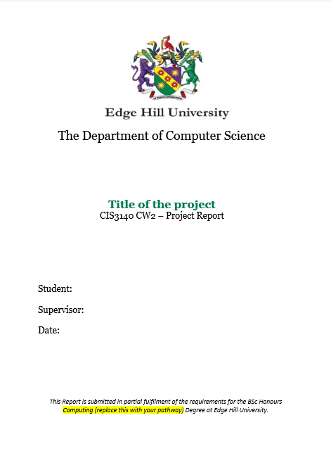
Cover Page
Project Title
Your name
Supervisor’s name
Date
Statement:
This Report is submitted in partial fulfilment of the requirements for the BSc Honours Computing (or Web Systems Development, or Computer Science) Degree at Edge Hill University

Slide 6
Chapter 1: Introduction
1.1 Introduction
Motivation / Outline of the problem
Background information
Purpose of the project
1.2 Aim and Objectives
Research questions / Hypothesis? If you have any
1.3 Scope
1.4 Methods
1.5 Ethics
1.6 Report Structure
Brief description of each chapter
This report consists of n chapters and is organised as follows

Slide 7
Those in Blue can be re-used from the proposal/interim report
Report (CIS3140, 8000 words)
(example)
Title
Chapter 1: Introduction
-Background and motivation
- Aims and Objectives
- Scope
- Methods used
- Ethics
- Structure of the report
Chapter 2: Background/lit review
Chapter 3: Problem analysis/requirements/methodology/research design
Chapter 4: Development/experiments
Chapter 5: Evaluation/testing/ data interpretation and recommendation
Chapter 6: Conclusions
- Critical evaluation of the process/ choices made
- Future work
References
Appendices
Proposal (CIS3161, 2000 words)
Title
1. Background/Lit Review
2. Aims and objectives
3. Methods
4. Project plan
5. Ethics
References
Appendices

Slide 8
Recommended content
Chapter 2: Background and Literature Review/Related work
Background work to your project
Project topic, main concepts and definitions, previous work…
Lit Review / Related work
Critical evaluation of other similar or related work
Research or technical publications related to your work
Discussions on /evaluation of similar software, applications/systems/frameworks/protocols/algorithms
Avoid unjustified/personal opinions
All opinion statements should be based on accepted facts that are referenced

Slide 9
Literature Review
Is Not
A report listing all the papers and books you have read
Describing/summarising the content of each paper/article
It must
Be organised around concepts/themes within the field
Critically evaluate past and current related research/work
Position your project within a wider context

Slide 10
Writing Lit review
Organise your writing around the concepts
e.g. there is considerable evidence for A (Smith, 2018; Rogers, 2019) and B (Jones, 2019; Rogers, 2019)
Not around authors
e.g. Smith (2018) found A, Jones (2019) also found B and Rogers’ work (2019) also concluded A and B

Slide 11
Suggested content
Chapter 3: Requirements gathering and analysis
(Project Requirements)
Describing the requirements gathering process, methods and techniques used in this process.
Describe where the requirements derived from and how the information was gathered
List the requirements
Full requirements spec as an appendix if necessary

Slide 12
Suggested content
Chapter 4: Design
Chapter 5: Implementation
Chapter 6: Testing
OR..
Chapter 4: Requirements and Design
Chapter 5: Implementation and Testing
Chapter 4:Development
4.1 1st Iteration/Increment 1
Design -> development ->testing
4.2 2nd Iteration/Increment 2
Design -> development ->testing

Slide 13
Suggested content
Chapter 3: Research Design
Description of the chosen research methods and the research process.
Also..
Requirements for tests, test parameters and variables, etc.
Questionnaire/interview questions design

Slide 14
Suggested content
Chapter 4: Data gathering and analysis/Experiments
Chapter 5: X_Y_Z Framework/protocol/method/approach/model
Describing design, development and testing of …

Slide 15
Chapter n (last): Conclusions
n.1 Summary of the project
Problem description
The Aim and how it was fulfilled
Used approach and methods
Results and limitations
n.2 Critical Evaluation
Choices made
Lessons learnt
n.3 Future work/directions

Slide 16
The rest
References
Provide reference list not Bibliography
Harvard style
No less than 10 academic references, preferably all combined 20 +
Appendices (examples)
Appendix A: Requirements Specification
Appendix B: Questionnaire example
Appendix C: Test data
Appendix D: User Manual
Appendix C: Project artefact (if paper-based)

Slide 17
Tips
Write in third person
Try to avoid
Terms: “clearly”, “obviously”
Opinions that are not based on accepted facts supported by the literature
Have all figures and tables numbered and captioned. Also explain them within the text
Set deadlines
Allow time for revision
Get someone to proof read

Slide 18
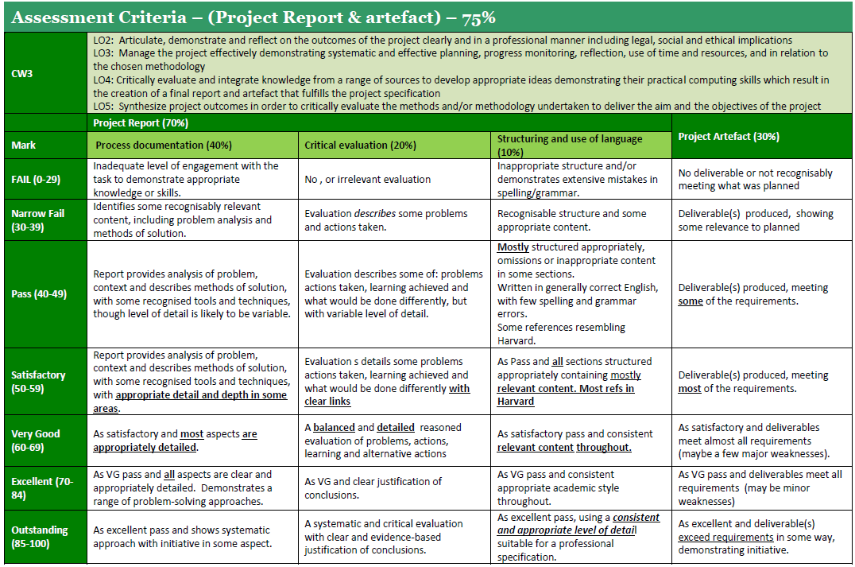

Slide 19


